Slide 1
Chemistry with Polymers
Dr.Widad Saleh
3rd Lecture
Polymer Analogous Reactions:-Reactions that involve parts of macromolecules, but that do not change their degree of polymerization, are known as polymer analogous reactions. The hydrogenation of unsaturated bonds in the polymer backbone or the hydrolysis of side groups are examples of these kinds of reactions.
P.acryl amide
PVAc

Slide 2
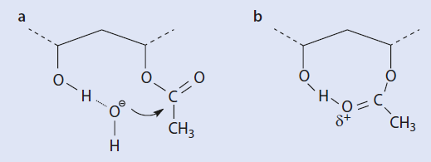
The OH functional groups formed during this reaction can—in contrast to the less polar acetate group—form hydrogen bonds with the attacking hydroxide ion. This favors the attack of these ions. As a result, an acetate group flanked by two groups which have already been hydrolyzed is around 100 times more reactive than with out these neighboring groups. This is why a strong acceleration in the rate of conversion as the reaction proceeds is observed

Slide 3
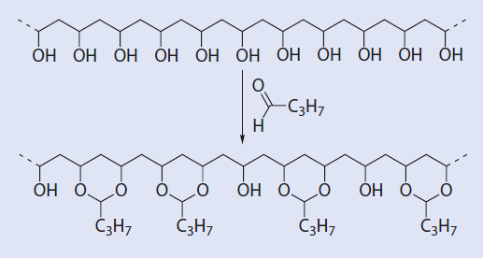
1- Intra- Vs. Intermolecular Reactions
In very dilute solutions the distance between the polymer coils (and therefore their functional groups) is especially large, whereas the distance between the functional groups within the polymer molecules is, at least initially, independent of the dilution. Thus, intramolecular reactions are more likely to take place during reactions involving a multifunctional reagent which can react with more than one of the functional groups of the polymer molecules
At high polymer concentration, intermolecular reactions, i.e., a linking of two polymer molecules, can occur to a lesser extent. Formally, this no longer qualifies as a polymer analogous reaction because the degree of polymerization significantly increases .To avoid such reactions, polymer analogous reactions are best carried out in dilute
solution.
Esterification of PVA to Poly vinyl butyral

Slide 4
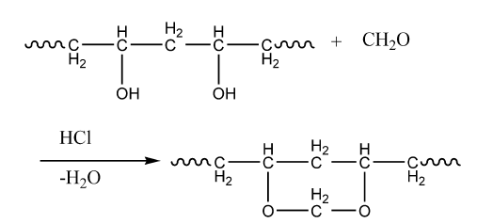
Formulation of PVA to Poly vinyl Formal
2- Technically Significant Polymer Analogous Reactions
The aromatic side group of polystyrene can be chemically modified in many different ways. These reactions are often used commercially for polystyrene that has been
cross-linked,

Slide 5
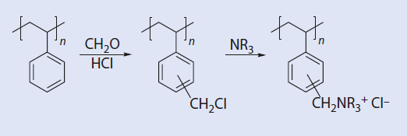

Slide 6
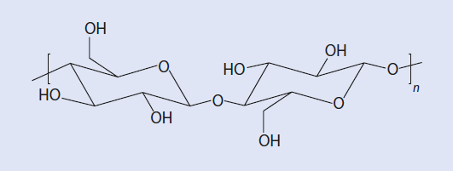
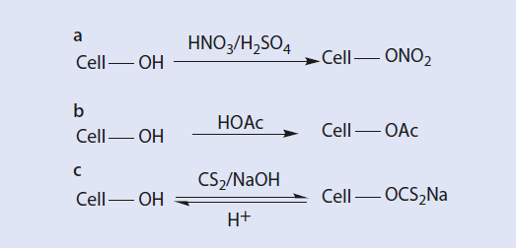
Structure of
cellulose and the d-glucose unit.
Conversion of cellulose to (a) cellulose nitrate(b) cellulose acetate, and (c) cellulose xanthate. Cell-OH
Textile fibers and
cigarette filters

Slide 7
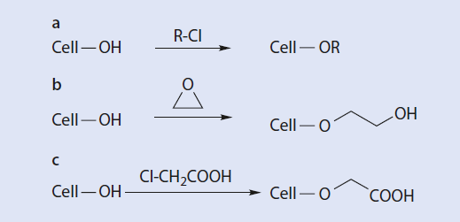
These materials are functional polymers (7 Chap. 19), for example as food thickeners
(E466), stabilizers for suspensions of nano particles, glues, pharmaceutical additives, and
flow improvers for concrete as well as for additives to textiles and paper. Cellulose ethers are also used as membrane substrates or, especially benzyl cellulose, as thermoplastic resins.

Slide 8
3-Cross-Linking Reactions
Cross-linking reactions result in covalent bonds between individual macromolecules and are thus, by definition, not polymer analogous reactions. However, the chemical cross-linking of polymers is also very important industrially, and has a great effect on their material properties, as mentioned briefly here:-
1- The glass transition temperature increases because of the decrease in the mobility of
the polymer chains and the increasing molar mass which approaches an infinite value
during cross-linking.
2- The strength of the material increases.
3- Because of the increase in molar mass, the solubility of the macromolecules decreases.
When cross-linking is complete, the material is completely insoluble

Slide 9
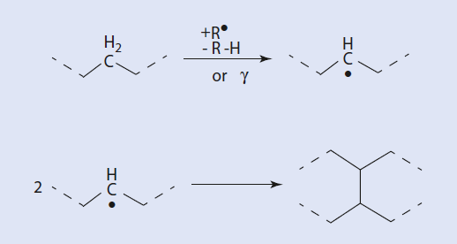
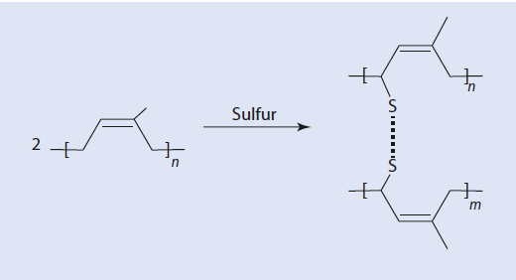
Cross-linking of
polymers by radicals or by radiation .
Vulcanization of
natural rubber (cis-polyisoprene)

Slide 10
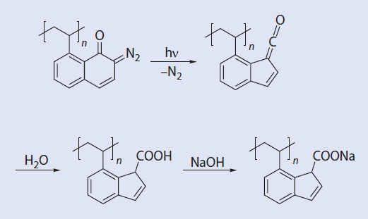
Increasing
polymer solubility by
introducing a polar group with the aid of light.
Photoresists The structuring of surfaces by light plays a crucial role in many industrial processes, especially
in the electronics industry for the production of micro-structured electronic components.
The structuring of polymeric surfaces can take place by a variety of means:
1- Increasing the solubility by radiation
2- Decreasing the solubility by radiation
Note :- Polymers referred to as “positive resists” (p-resists) become more soluble on exposure to
light of a suitable wavelength

Slide 11
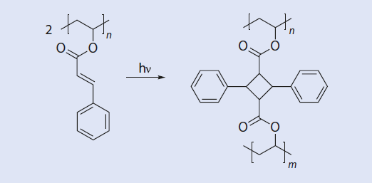
Reduction of
polymer solubility by
photochemical cross-linking
So-called “negative resists” (n-resists) display exactly the opposite reaction when they are
irradiated: they become insoluble. The easiest way to achieve this is by photochemical
cross-linking

Slide 12
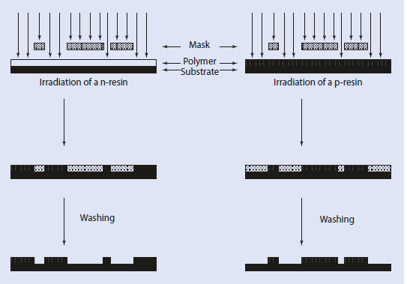
Structuring surfaces covered with n- or p-resists

Slide 13
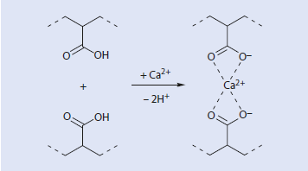
4- Thermo reversible Cross-Linking: Ionomers
Chemical cross-linking reactions in which covalent bonds are formed are irreversible processes.
The products generally have useful material properties; however, they are infusible
and insoluble so they cannot be changed into a different shape by melting or dissolution.
In contrast to this, there are materials which are reversibly cross-linked by non-covalent,
physical cross-links. One particular example is materials cross-linked via ionic interactions,
such as the copolymers of ethylene with 5–10 wt% acrylic acid. These macromolecules
can be ionized using alkaline solutions and then cross-linked using multivalent ions
such as Ca2+
Note :- the material can be
melted and reshaped. New ionic links are formed again as the material cools.

Slide 14
5- Degradation Processes in Polymeric Materials
Similar to non-polymeric materials, which age over the course of time (they become rusty
or weathered), most polymeric materials also show signs of ageing to a greater or lesser
extent when exposed to the environment. Ageing can be brought about by:
1- Temperature stress
2- Light or UV radiation
3- Oxygen
4- Water (hydrolysis)
5- Microorganisms (biodegradation)
6- Mechanical stress
Depolymerization of polymers
Chain scission of a polymers

Slide 15
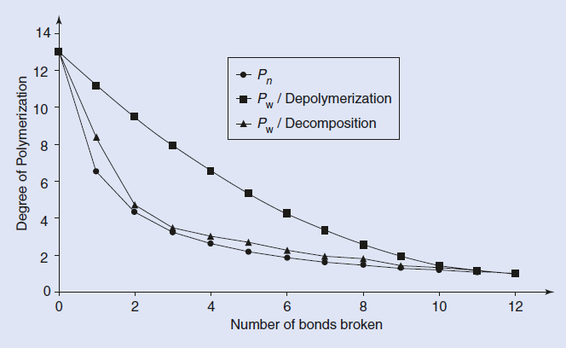
The ageing of polymers involves in particular the following processes:
1- Depolymerization
2- Chain scission
3- Oxidation and cross-linking

Slide 16
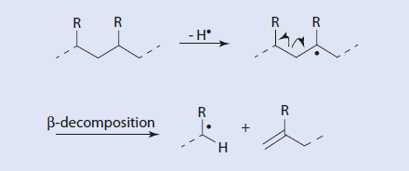
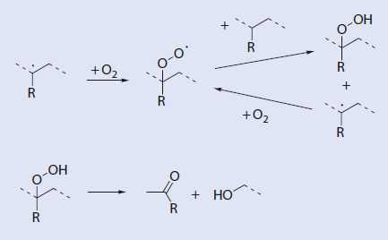
Degradation Mechanism
Radical chain scission with out oxygen
Oxidation of polymer radical

Slide 17
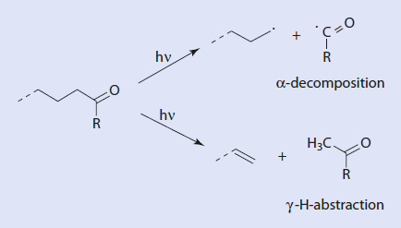
Photochemical decomposition of poly ketone

Slide 18
6- stabilization of polymers
Polymer materials can be stabilized by basically two types of compounds: antioxidants and UV stabilizers. These compounds are added to the polymer as additives during processing. A prerequisite for effectiveness is the miscibility of the additive with the polymer.
Primary Antioxidants
Primary antioxidants are often sterically hindered phenols such as 2,6-di-tert-butyl-4-methylphenol
(butylated hydroxytoluene, BHT). These substances saturate radicals by transferring a hydrogen atom and so terminate the reaction chain. The BHT radicals formed during this process take part in various follow-up reactions by combining with another radical, by dimerization, or by disproportionation .
Secondary Antioxidants
Sterically hindered amines, thioethers, or phosphites are used to reduce peroxides that
have already been formed. A specific feature of amines is that they can react with peroxy
radicals and with polymer radicals and can thus decrease the total radical concentration
in the polymer. These processes are shown in .

Slide 19
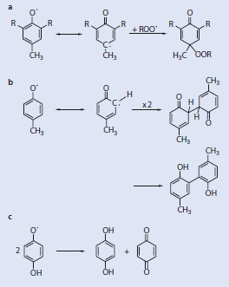
Reaction mechanism of phenolic resin ,a- addition to radicals, b-dimerization and c- disproportionation

Slide 20
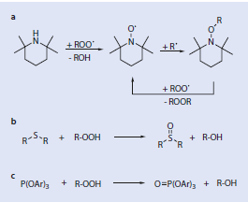
Reduction of peroxides ,a- by tetramethyl pipeidine as sterically hindred amines ,b-by thioethers and c-by ter.phosphite

Slide 21
Thank you
WIDAD SALIH

